Slide 1
On The Analysis Of
Public School Data
Ethan Liu

Slide 2
General Information
Public schools in the US is generally handled by local communities
Funded by federal, state and local governments
Average number of schools per district: 6.79
Standard deviation of 17.3
Data of 13032 school districts used
12978 in the continental 48 states and DC

Slide 3
Data adopted:
NCES Common Core of Data (CCD),
Non-fiscal year 2019-2020
School district level data
Contains statistics per school district by race
NCES Education Demographic and Geographic Estimates (EDGE)
School year 2019-2020
School district level data
Geographical features of a school district: longitude, latitude, land area covered by school district.
Notes:
https://nces.ed.gov/ccd/files.asp

Slide 4
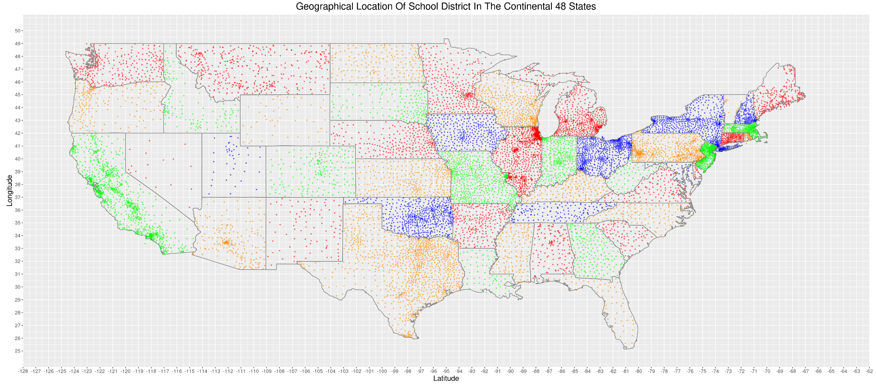
General Information
Note: colors are only meant to distinguish between states!

Slide 5
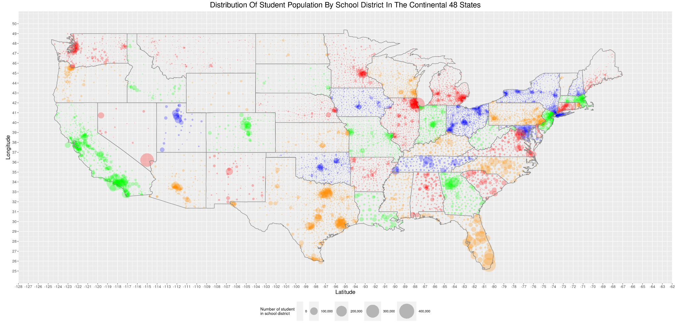
General Information

Slide 6
Racial Composition
Race | Total | Percentage
American Indian or Alaska Native | 480023 | 0.95%
Asian | 2691285 | 5.31%
Black or African American | 7596346 | 15.00%
Hispanic/Latino | 13990590 | 27.62%
Native Hawaiian or Other Pacific Islander | 185022 | 0.37%
Two or more races | 2187659 | 4.32%
White | 23520110 | 46.44%

Slide 7
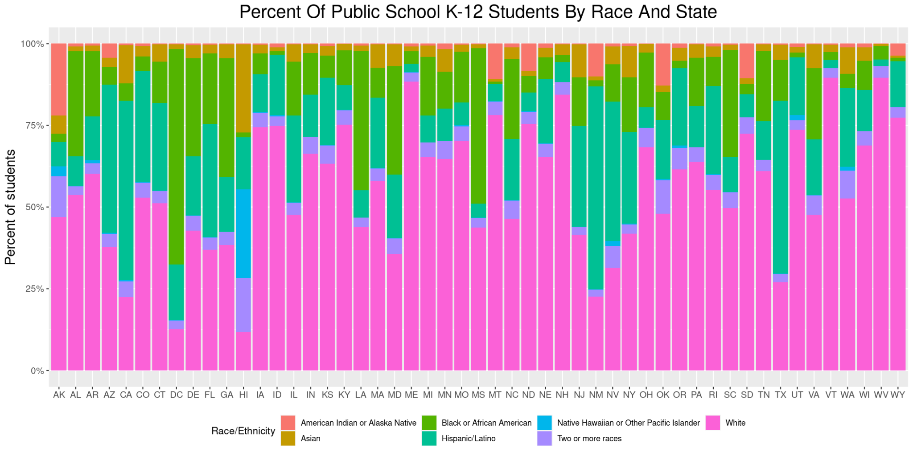

Slide 8
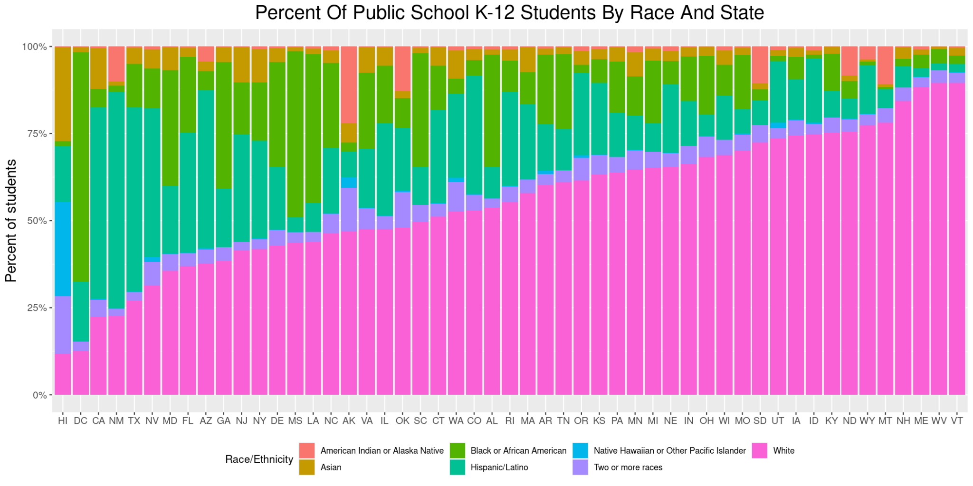

Slide 9
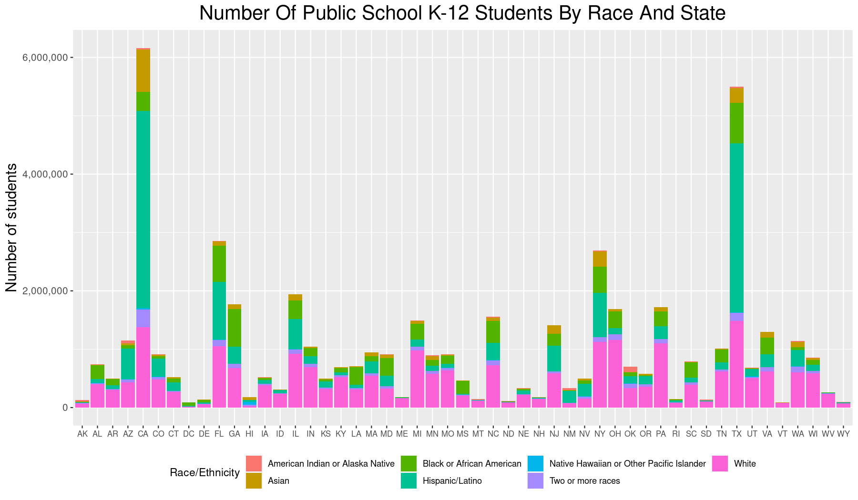

Slide 10
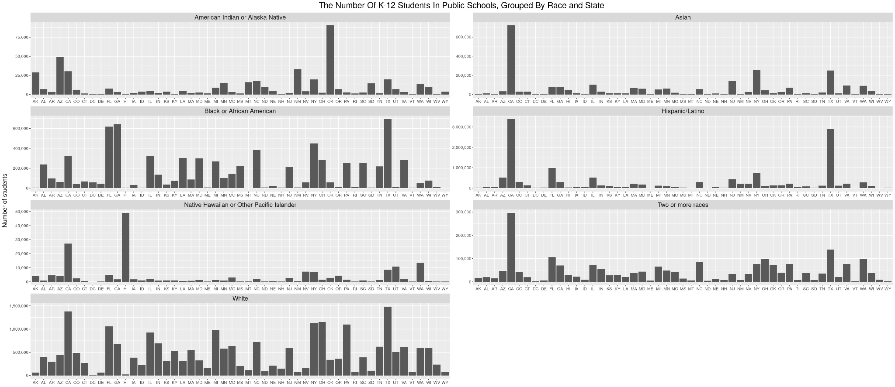

Slide 11
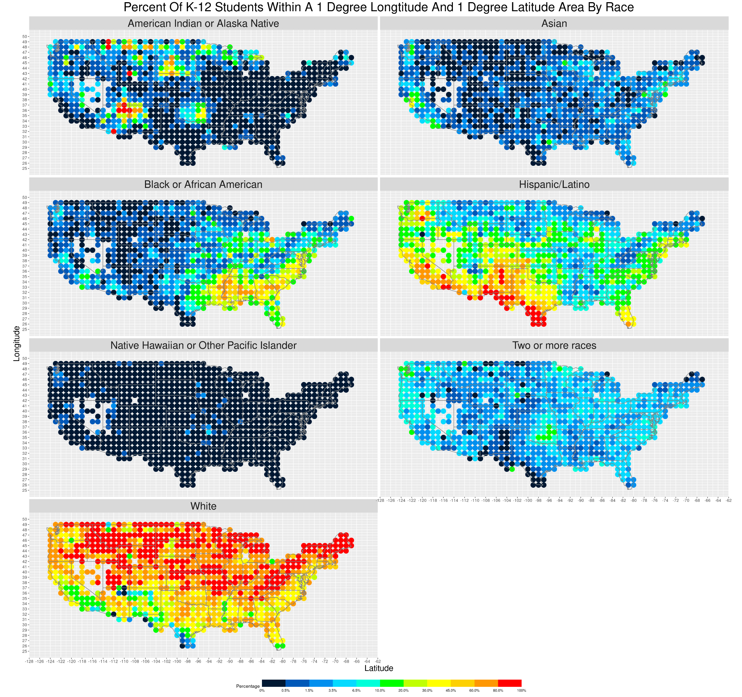
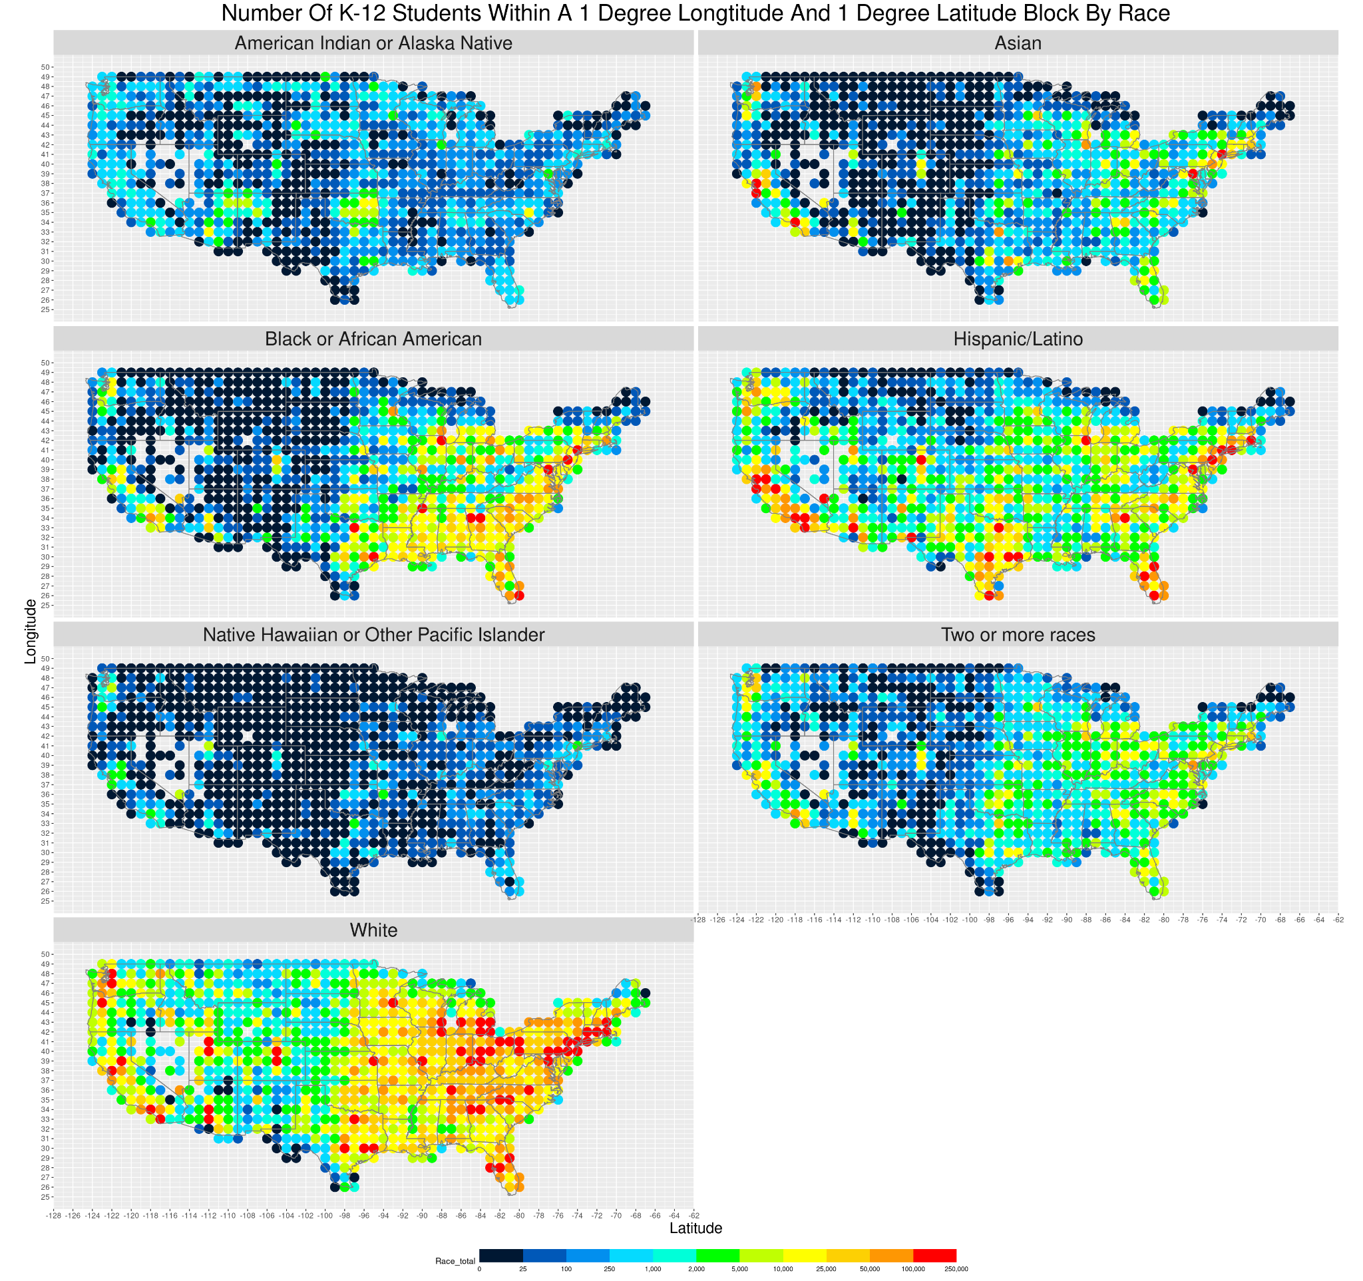

Slide 12
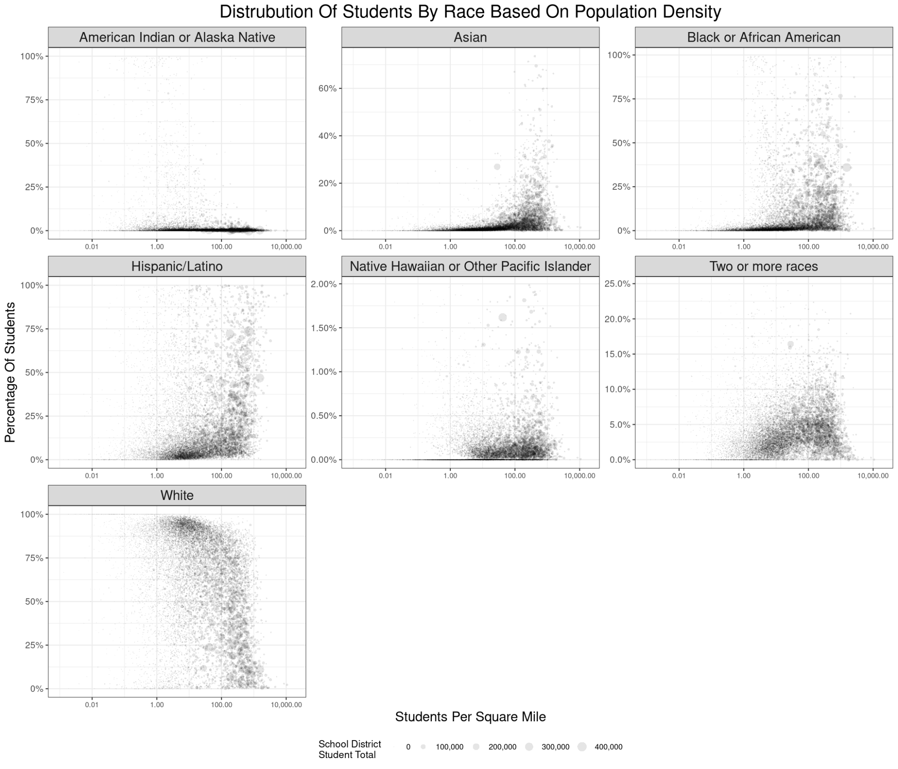
Is it possible to construct a linear regression model?

Slide 13
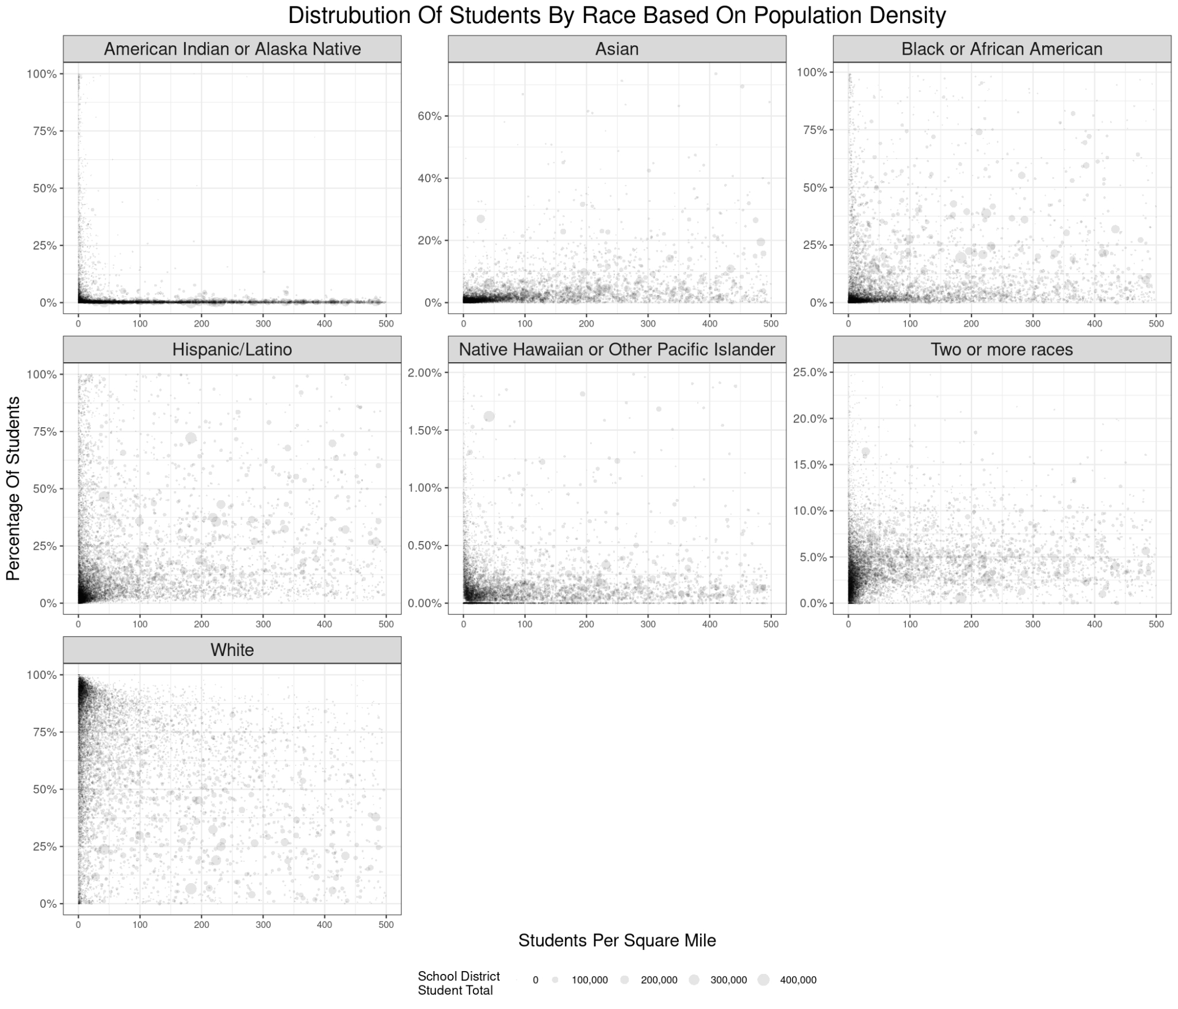
It is not possible to construct a linear regression model
The data points are not equally weighted
The data has a very wide spread, and should linear regression be applied, it will not have a strong correlation.

Slide 14
Thank you!

